Slide 1


Mo d u l e - 4
PACKAGES AND MULTI THREADING

Slide 2

Course Topics
→ Module 1
» Introduction to
Java
→ Module 2
» Data Handling and
Functions
→ Module 3
» Object Oriented Programming in
Java
→ Module 4
» Packages and Multi-threading
→ Module 8
» Servlets
→ Module 9
» JSP
→ Module 10
» Hibernate
→ Module 11
» Spring
→ Module 5
» Collections
→ Module 12
» Spring, Ajax and Design
Patterns
→ Module 13
» SOA
→ Module 6
» XML
→ Module 7
» JDBC
→ Module 14
» Web Services

Slide 3

Objectives
At the end of this module, you will be able to
→ Implement interface and use it
→ Extend interface with other interface
→ Create package and name it
→ Import packages while creating a new class
→ Understand various exceptions
→ Handle exception using try catch block
→ Handle exception using throw and throws keyword
→ Implement threads using thread class and runnable interface
→ Understand and implement multithreading

Slide 4


John gets a Task
Hi John, we are conducting a training session for fresher's in our company. I want you to lead it.

Slide 5
John to train Fresher's!
Yes, sure!!

Slide 6

John starts Training
Hello guys! My Name is John. I work as a Senior Programmer. Today, I am here to share my knowledge with you all.

Slide 7

John talks about Interfaces
Interfaces
We will learn about Interfaces!!

Slide 8




John explains Interface with an Example
Every remote whether it is a TV remote or gaming remote needs to have certain specifications. For example power button, directional buttons etc. which are common to every remote.
Hence an interface contains all these specification and can be used while creating a
new remote.

Slide 9
John explains Interface and Specifications
→ An interface has set of method declarations and specifications.
→ Statement of requirements that prescribes a method of achieving a desired standard, instead of prescribing the standard itself is called specification.
Let us learn about it in details.

Slide 10










Why are “Interfaces” used?
→ Interfaces are used to implement the expected behaviour of a system / datatype.
→ Java does not support multiple inheritance, hence interfaces are implemented.
class
class
A class can extend 1 class but implement many interfaces.
class
n
interface
interface

Slide 11













Interface
Interface
Implements
Class
→ An interface has a set of method
declarations.
→ It does not have the method body but only method declaration.
→ To use an interface in a class, “implements” keyword is used.
→ In case you don't override all the methods in
the class the class has to be defined as abstract.
→ An interface is same as class except class can be instantiated but interface cannot be.
abstract Method1();
abstract Method1()
{
}
abstract Method2()
{
abstractMethod2();
abstract Method3();
}
→ An interface can be defined by using interface keyword and the name of the interface.
» interface interface1{}
abstract Method3()
{
}

Slide 12

Where do we use interfaces?
Any system which needs the expected functionality, requires interfaces.
For example, 2 basic functions of a bank is deposit and withdraw. These two functions can be part of interfaces for banking application.

Slide 13

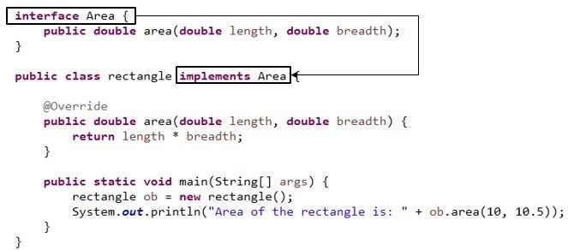
A Program on Interface

Slide 14








Interfaces
→ Attributes can be defined in interfaces.
→ These attributes can be used in the implemented class.
→ The attribute values can’t be changed in the class as it acts like finalvariables.
Class | implements | Interface
Interface
i
 | extends
Subclass
Class implementing an interface
Class extending an Abstract class which implements an interface

Slide 15

Annie’s Question
What is a final variable?

Slide 16
Annie’s Answer
If the variable is declared as final, the value of that variable cannot be modified.

Slide 17

LAB

Slide 18

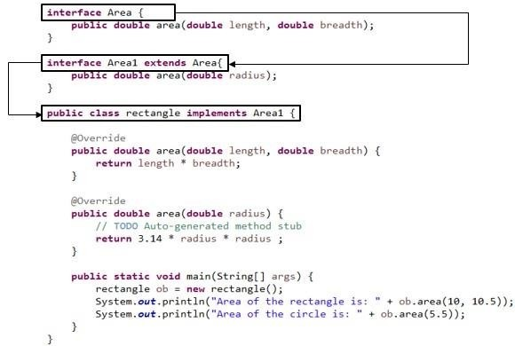
Interfaces can be Extended

Slide 19
Interfaces can be Extended (Contd.)
→ Like the classes can be extended, even interfaces can be extended.
→ In the above program, there are two interfaces, interface1 and interface2.
→ Interface2 is extended from interface1. If a class is implementing interface2 then all the methods of interface2 and 1 should be implemented, as interface2 is extended from interface1.

Slide 20
Packages

Slide 21
Why Packages?
→ Programmers can easily determine that these classes arerelated.
→ Programmers know where to find files of similar types.
→ The names won’t conflict.
→ You can have define access of the types within the package.

Slide 22
What is a Package?
→ A Java Package is a mechanism for organizing Java classes into namespaces
→ Programmers use package to organize classes belonging to the same category
→ Classes in the same package can access each other’s package-access members

Slide 23
Naming Convention of a Package
Package names are written in all lower case. (It is not mandatory. However, it is standard convention that is followed)
Companies use their reversed internet domain name to begin their package names.
For example: com.example.mypackage for a package named mypackage created by a programmer at example.com

Slide 24
Naming Convention of a Package
If the domain name contains:
→ a hyphen or a special character
→ If the package name begins with a digit, illegal character reserved Java keyword such as “int”
In this event, the suggested convention is to add an underscore as follows:
Legalizing Package Names
Domain Name | Package Name Prefix
hyphenated-name.example.org | org.example.hyphenated_name
example.int | int_.example
123name.example.com | com.example_123name

Slide 25
















Packages
MyClass.java
myproject
com
src
Project
bin
com
myproject
MyClass.class

Slide 26
Annie’s Question
What can be the advantage of having all the related classes in one package?

Slide 27
Annie’s Answer
It is modularized.
Easy to handle. Easy to copy from one location to
another.
All the classes in the package can be loaded at one time
import and * character.

Slide 28
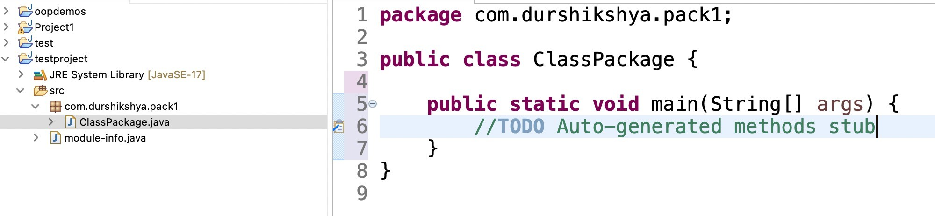
Program on Package
Company URL → durshikshya.com Package name → com.durshikshya.pack1

Slide 29


Package and Import
→ A package can have many classes and each class can have many methods.
→ These methods can be used by another class in another package by using the keyword “import”.
→ Syntax is: import <package name>. <class name>
→ Or import <package name>.*; → This loads all the classes in the given package.
→ We can also import static members. For eg: PI, cos etc.

Slide 30
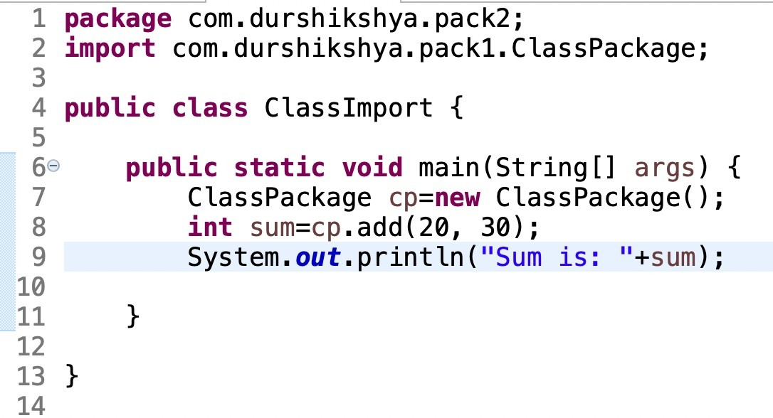
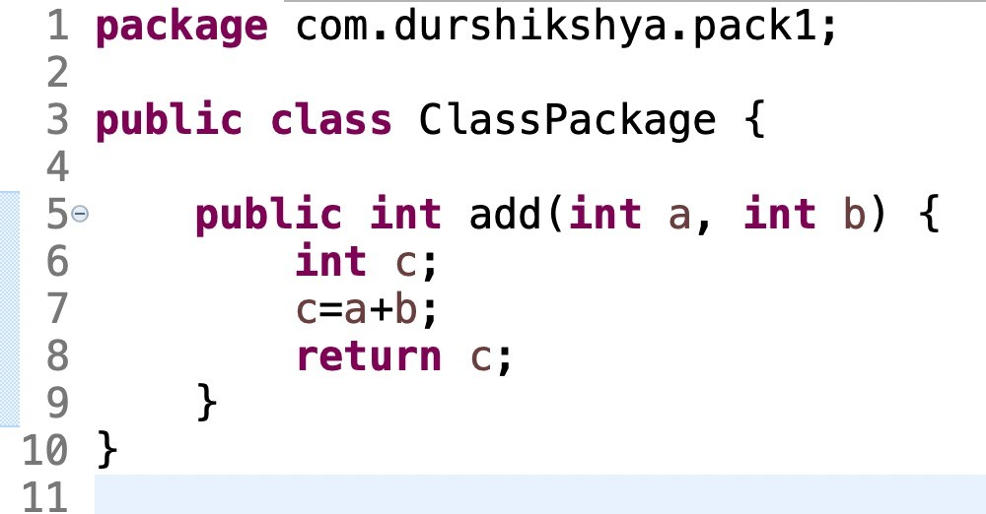
Program on Packages

Slide 31










Access Modifiers
There are 4 Access Modifiers:
Access Modifiers
Public
Private
Protected
Default or package
These Scope Modifiers can be used for an attribute or for a method.

Slide 32
Access Modifier
Access Modifier specifies the scope/accessibility of a variable or a method or a class from the same class or from a different class or from a different package.
Use of Access Modifier:
Data abstraction / hiding is one of the concept of Object Oriented Programming. This means, client will not know the implementation details.
This can be achieved through Access Modifier.
For Example: If an attribute is made private then it can be accessed only in the class which defined it.

Slide 33









Access Modifier – Public
Public: When an attribute or method is declared as public then it can be accessed anywhere. Any package, any class accessibility is available.
co.durs.pack1
Class1 Public Members
co.durs.pack2
Class5
Class2
Class4 Extends Class1
Class3

Slide 34








Access Modifier – Protected
Protected: When an attribute or method is declared as protected then it is visible to all the classes in the same package and all subclasses in different package.
co.durs.pack1
Class1 Protected Members
co.durs.pack2
Class5
Class2
Class4 Extends Class1
Class3

Slide 35





Access Modifier – Private
Private: If a Method, Variable or Constructor is defined as private then it can only be accessed within the declared class itself. Access is not available outside the class.
co.durs.pack1
Class1 Private Members
co.durs.pack2
Class5
Class2
Class4 Extends Class1
Class3

Slide 36
Access Modifier –
Default
Default: When no access modifier is defined then it is said to have default access modifier. This attribute/method is used only in the given package. It is not accessible outside the package.
co.durs.pack1
Class1 Default Members
co.durs.pack2
Class5
Class2
Class4 Extends Class1
Class3

Slide 37
Access Levels
Modifier | Class | Package | Subclass | World
Public | Y | Y | Y | Y
Protected | Y | Y | Y | N
No modifier | Y | Y | N | N
private | Y | N | N | N

Slide 38
LAB

Slide 39
Exception
An exception is an event, which occurs during the execution of a program, that disrupts the normal flow of the program's instructions -- Oracle
It is often referred to as run-time error. Below are few of them:

Slide 40





Types of Exception
Exception
Checked Exceptions
Runtime Exceptions
Error
Checked exceptions are checked at compile-time.
It means if a method is throwing a checked exception then it should handle the
exception using try-catch block or it should declare the exception using throws keyword, otherwise the program will give a compilation error.

Slide 41
Types of Exception
Exception
Checked Exceptions
Runtime Exceptions
Error
Unchecked exceptions are not checked at compile time. It means if your program is throwing an unchecked exception and even if you didn’t handle/declare that exception, the program won’t give a compilation error. It is up to the programmer to judge the conditions in advance, that can cause such exceptions and handle them appropriately.
All unchecked exceptions are direct sub classes of RuntimeException class.

Slide 42
Types of Exception
Exception
Checked Exceptions
Runtime Exceptions
Error
These are exceptional conditions that are external to the application, and that the application usually cannot anticipate or recover from. For example, if a stack overflow occurs, an error will arise. They are also ignored at the time of compilation.

Slide 43



















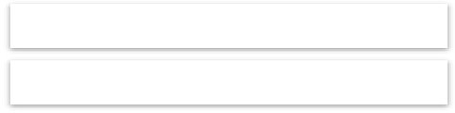

Exception Class
java.lang
Throwable
 |  | ArithmeticException
 |  | ArrayStoreException
 |  | ClassCastException
 |  | IllegalArgumentException
 |  | IllegalMonitorException
 |  | IndexOutOfBoundsException
 |  | NegativeArrayException
 |  | NullPointerException
 |  | SecurityException
 |  | Other unchecked exceptions
Error
Exception
java.lang.InterruptedException
RuntimeException
java.sql.SQLException
java.io.IOException

Slide 44
Why Exceptional Handling?
// Divide by Zero Problem
int x = 5 / 0;
System.out.println(x);
error!
Program will halt.
Output
Or
// Array Index Out of Bound
int arr[] = {1, 2, 3};
System.out.println(arr[3]);
error!
Program will halt.
Output

Slide 45
Solution
try {
// Divide by Zero Problem int x = 5 / 0; System.out.println(x);
} catch (Exception e) {
System.out.println("Divide By Zero exception occured");
}
Output:
Using Exception handling the execution will continue even if an exception has occurred. The program will not halt because the exception was handled.

Slide 46
Exception Handling
→ If there is a run time error then program is crashed and control comes out of the program.
→ This issue can be solved by exception handling.
→ Mainly, try, catch and finally are keywords for exception handling.

Slide 47

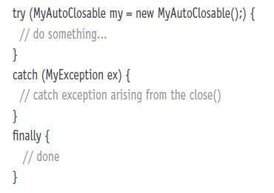
Exception Handling (contd.)
→ try: All the statements to be executed should be placed in the try block.
→ catch: If there are any issues or runtime errors, control comes in catch block.
→ finally: Whether successful or unsuccessful execution, statements in the finally block gets executed.
Finally block is required to release the resource and required for clean up purposes.

Slide 48

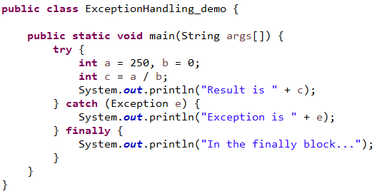
Program on Exception Handling

Slide 49
Exception Handling
One try can have multiple catch blocks. In this scenarios, depends on the type of exception thrown corresponding catch block is invoked.
Since all the exceptions are derived from Exception, catch (Exception e) should be placed at last. It can catch all the exceptions.

Slide 50

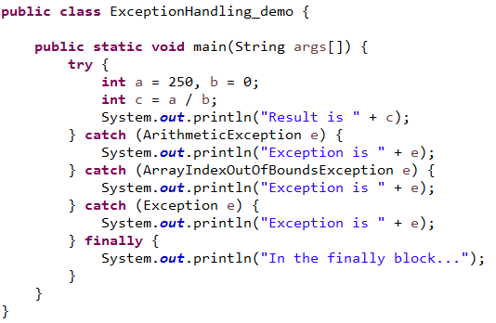
Program on Mutiple Catch Blocks

Slide 51
Nested try catch
Why use nested try block?
Sometimes a situation may arise where a part of a block may cause one error and the entire block itself may cause another error. In such cases, exception handlers have to be nested.
Syntax:
try
{
statement 1;
try
{
statement 1;
}
catch(Exception e)
{
}
}
catch(Exception e)
{
}

Slide 52

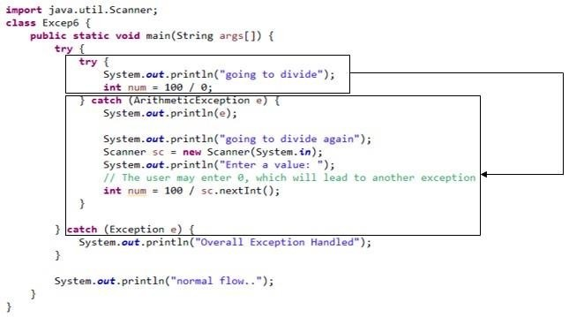
Program on Nested try catch

Slide 53

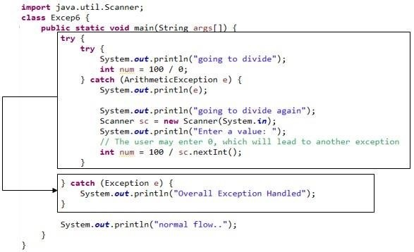
Program on Nested try catch

Slide 54
Why throw?
Example 1: If there is a chance of a serious logic error or operational error then developer can also throw an exception. For example, if we are developing software for elections. For voting, minimum age required is 18. If the voter's age is below 18 then we can not continue any further, as the basic requirement itself is not met, hence developer can throw anexception.
Example 2: In banking application, one user account is blocked or closed and if the bank gets the cheque to clear the amount from this account then it is not possible to continue any further hence developer can throw an exception.
All the possible scenarios, developer has to use the throw keyword to throw an exception.

Slide 55

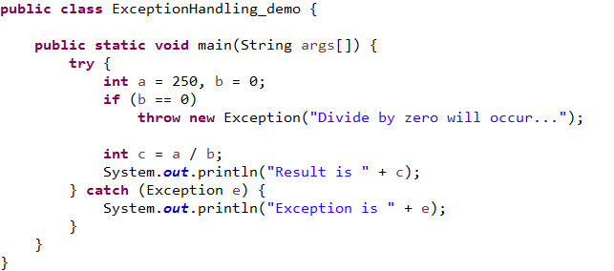
Throw

Slide 56
Why throws?
Design requirement: In an organization, employees provide the service. If there are any issues, in some scenarios, it is not possible for the employees to handle and it has to be escalated to the management to handle it. For example, contract signatures, handling legal issues etc.
Similarly in Java, method which provides the service may not be required to handle certain exceptions and those exceptions should be handled by the callingfunction.

Slide 57
Throws
Throws will be used next to a function declaration statement as givenbelow:
Public void test() throws IOException
This statement states that the function test() will not handle IOexception and thecalling function will handle these IOException. Calling function is responsible for IOExceptions.
Many exceptions can be added by adding comma operator as givenbelow:
Public void function() throws IOException, ArrayIndexOutOfBoundsException

Slide 58

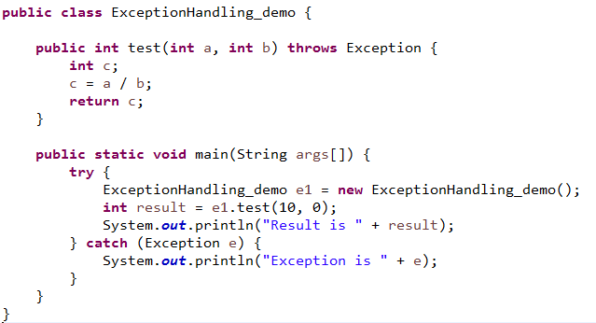
Program on Throws

Slide 59















Program Vs Process Vs Thread
Program: A program is a set of instructions stored in the secondary storage device that are intended to carry out a specific job. It is read into the primary memory and executed by the kernel.
Process: An executing instance of a program is called a process. It is also referred as a task.
Thread: A thread is called a ‘lightweight process’. It is similar to a real process but executes within the context of a process and shares the same resources allotted to the process by the kernel.
Program
Process2
Within a Process
Process 3
Process1
Process3
Thread 1
Thread 2
Thread 3
Process4
Process5
Thread 4
Thread 5
Process6
Process7
Thread 6
Thread 7

Slide 60








Multi Threading
Every computer has multiple processes running at a time.
Playing Video
Music Player
My Super Computer
Browse Internet
Notepad
Other Tasks
Playing Game

Slide 61








Multi Threading (contd.)
Every Application has multiple sub-processes running at a time.
Playing Songs
Managing Playlists
Music Player
Downloading Updates
Accessing Internet

Slide 62
Multi Threading (contd.)
Thread is a task to be performed. Multi threading is multiple tasks getting executed at thesame time in the same program / process.
Multi threading takes the same memory space for any number of threads.

Slide 63
Annie’s Question
What are the advantages of implementing multi threading in a Java program?

Slide 64
Annie’s Answer
Since multiple processes/tasks run at the same time, time is saved, hence speed increases.
Instead of running two programs, the same can be achieved by running two threads in the same memory space, hence
memory consumption also decreases.

Slide 65
Multi Threading
In Java, a thread can be implemented in two ways:
→ extending from a thread class
→ implementing runnable interface

Slide 66
Extending Thread - Example
class Thread1 extends Thread {
public void run() {
}
// Code goes here

Slide 67

LAB

Slide 68
Runnable Interface - Example
class Circle implements Runnable {
@Override
public void run() {
}
}
// Code goes here
Need of Runnable Interface:
→ In Java Inheritance is limited to one classonly.
→ If a class extends non-thread class, then it can’t extendthread.
→ So to provide multi-threading into a class that already extends some other class, we use Runnable.

Slide 69
LAB

Slide 70
Constructors of Thread Class
Thread()
Thread(String name)

Slide 71
Other Constructors of Thread Class
Thread(Runnable)
Thread(Runnable, String)
Thread(ThreadGroup, String)
Thread(ThreadGroup, Runnable) Thread(ThreadGroup, Runnable, String)
Thread(ThreadGroup, Runnable, String, long)

Slide 72
Thread - LifeCycle
New: At this point, the thread is considered notalive.
Runnable: A thread first enters runnable state after the invoking of start() method.
Running: A thread is in running state that means the thread is currently executing. Blocked: A thread can enter in this state because of waiting for the resources or sleeping.
Terminated: A thread can enter in this state when run() method completes. After thismethod thread cannot ever run again.

Slide 73











Thread - LifeCycle
New
Program startsthread
Unlocksignal
Runnable
Thread completestask
Waiting
Terminated
Awaitlock
Await sleep
Interval express
Timed Waiting

Slide 74




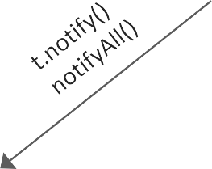






Thread - Methods
New
Blocked
t.start()
t.sleep(),
t.wait()
Ready
t.run()
Running
Run methodends
Terminated
→ Start() method should be called to start a thread.
→ Start() will call the run()method.
→ Run() will have the actual task to be performed by the thread.

Slide 75














Synchronization
Synchronization is the coordination of events to operate a system in unison.
Synchronization is achieved by the use of locks in Java.
Synchronous
Asynchronous
System
Test
Test
System

Slide 76


Locks in Java
A lock is a tool for controlling access to a shared resource by multiple threads.
Get lock. Yay!
Static lock object
There are four different kinds of locks:
Thread
Fat locks: A fat lock is a lock with a history of contention (several threads trying to take the lock simultaneously), or a lock that has been waited on (for notification).
Thin locks: A thin lock is a lock that does not have any contention.
Thread waiting for lock
Recursive locks: A recursive lock is a lock that has been taken by a thread several times without having been released.
Lazy locks: A lazy lock is a lock that is not released when a critical section is exited. Once a lazy lock is acquired by a thread, other threads that try to acquire the lock have to ensure that the lock is, or can be, released.
Thread waiting for lock
Thread waiting for lock

Slide 77







Deadlock
Deadlock describes a situation where two or more threads are blocked forever, waiting for each other.
Or
A deadlock is a situation in which two or more competing actions are each waiting for the other to finish, and thus neither ever does.
R1
P1
P2
R2

Slide 78

Carl explains Thread Synchronization
Let me introduce you to thread synchronization with an example.

Slide 79
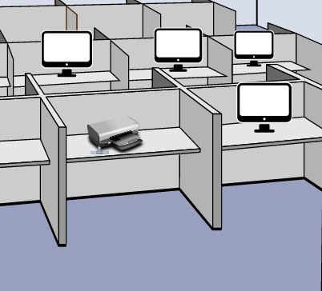
Example
Assume a printer is connected to 4 computers.

Slide 80
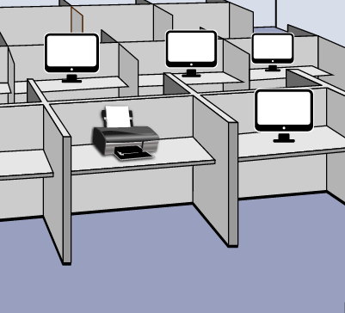




Example
All the 4 computers requests to print a document. Printer starts to print first computer document. The second and the other computer documents should be waiting till the first computer document gets printed.

Slide 81
This happens in Java - Thread Synchronization
Similarly, when two or more threads try to access the same resource simultaneously it causes the Java runtime to execute
one or more threads more slowly, or even
suspend their execution.
The concept of one thread to execute at a time and rest of the threads in waiting state is called thread synchronization.

Slide 82
LAB

Slide 83

Q u est i ons

Slide 84

Assignment - Interfaces
→ Write a program to define a queue interface and have insert and delete methods in the interface.
Implement these methods in a class.

Slide 85
Assignment - Packages
→ Write a program to define functions for subtract, multiply, divide, factorial and reversingthe digits of a number in a package, import this class in another package and use all the methods defined in the primary package.

Slide 86
Assignment - Exception
→ Write a program to demonstrateArrayIndexOutOfBoundsException.

Slide 87
Assignment - Thread
→ Write a program to print tables of 5 by creating a new thread and display 20 even numbers as a task of main thread.

Slide 88

Agenda for the Next Class
In the next class, you will be able to
→ Identify and use important Inbuilt Java Packages like java.lang, java.io, java.util etc
→ Use wrapper classes
→ Understand collections framework
→ Implement logic using arraylist and vector and queue
→ Use set, hashset and treeset
→ Implement logic using Map HashMap and HashTable

Slide 89


Pre-work
Brush up on Databases, records.

Slide 90
Survey
Your feedback is important to us, be it a compliment, a suggestion or a complaint. It helps us to make the course better!
Please spare few minutes to take the survey after the webinar.

Slide 91


